Slide 1
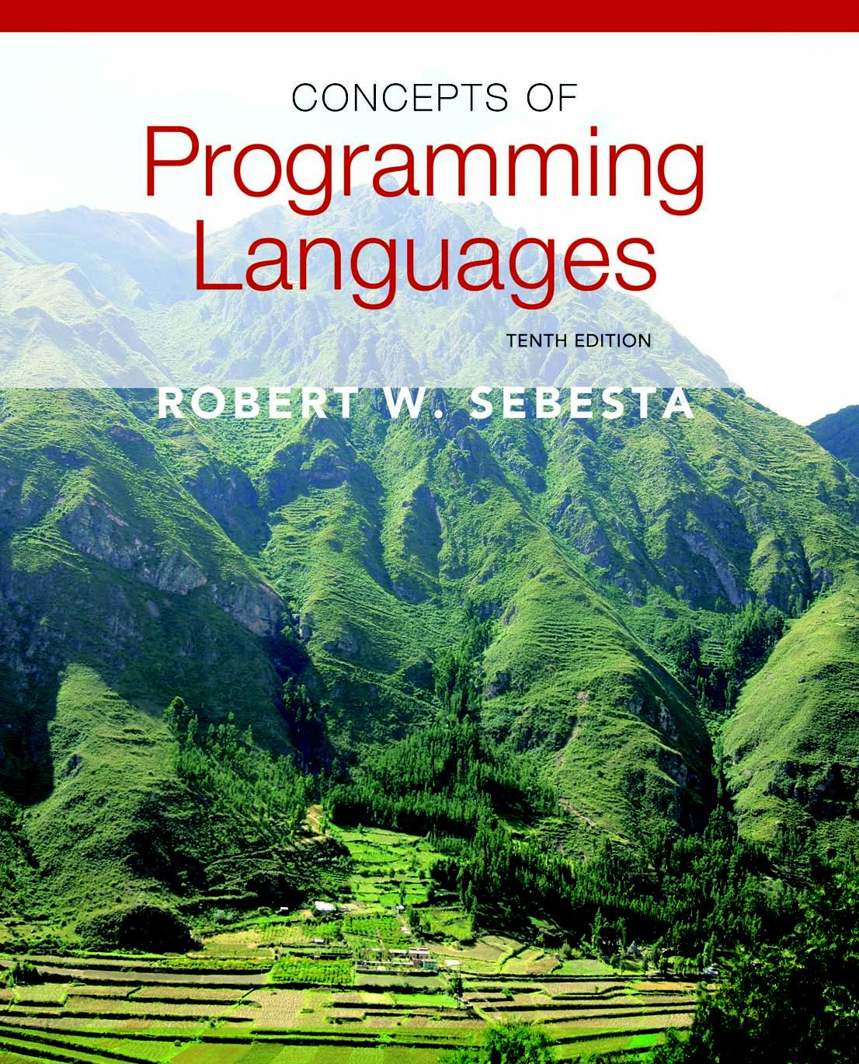
Copyright © 2012 Addison-Wesley. All rights reserved.

Slide 2
Lecture 7: Subprograms
CS4080
(Chapters 9 & 10 )

Slide 3
Topics
Fundamentals of Subprograms
Design Issues for Subprograms
Local Referencing Environments
Parameter-Passing Methods
Subprograms as Parameters
Overloaded Subprograms
Generic Subprograms
Design Issues for Functions
User-Defined Overloaded Operators
Coroutines

Slide 4
Fundamentals of Subprograms
Process abstraction vs. Data abstraction
Process abstraction: subprograms
Data abstraction: classes and objects
Fundamentals of subprograms
Each subprogram has a single entry point
The calling program is suspended during execution of the called subprogram
Control always returns to the caller when the called subprogram’s execution terminates

Slide 5
Basic Definitions
A subprogram definition describes the interface and the actions of the subprogram abstraction
A subprogram call is an explicit request that the subprogram be executed
A subprogram header is the first part of the definition, including the name, the kind of subprogram, and the formal parameters
The parameter profile (aka signature) of a subprogram is the number, order, and types of its parameters
The protocol is a subprogram’s parameter profile and, if it is a function, its return type
A subprogram declaration provides the protocol, but not the body, of the subprogram (note: subprog def. vs. subprog decl.)
Function declarations in C and C++ are often called prototypes

Slide 6
Actual/Formal Parameter Correspondence
Positional
The binding of actual parameters to formal parameters is by position
Safe and effective
Keyword
The name of the formal parameter to which an actual parameter is to be bound is specified with the actual parameter
Advantage: Parameters can appear in any order, thereby avoiding parameter correspondence errors
Disadvantage: User must know the formal parameter’s names
Default parameter values
In certain languages (e.g., C++, Python, Ruby, Ada, PHP), formal parameters can have default values (if no actual parameter is passed)
In C++, default parameters must appear last because parameters are positionally associated

Slide 7
Design Issues for Subprograms
Procedures vs. Functions
Procedures are collection of statements that define parameterized computations
Functions structurally resemble procedures but are semantically modeled on mathematical functions
side effect free (expectation only, not in practice)
Are local variables static or dynamic?
What parameter passing methods are provided?
Are parameter types checked?
Can subprogram definitions appear in other subprogram definitions? i.e. nested subprograms?
If subprograms can be passed as parameters and subprograms can be nested, what is the referencing environment of a passed subprogram?
Can subprograms be overloaded?
Can subprogram be generic?

Slide 8
Local Referencing Environments
Local variables usually are stack-dynamic
- Advantages
Support for recursion
Storage for locals is shared among some subprograms
Disadvantages
Allocation/de-allocation, initialization time
Indirect addressing
Subprograms cannot be history sensitive
Local variables can be static
E.g. static variables
Advantages and disadvantages are the opposite of those for stack-dynamic local variables

Slide 9
Parameter Passing
Models
in
out
in and out
Conceptual model of parameter transfer
Physically move a path
e.g. By value
Move an access path
e.g. By reference

Slide 10
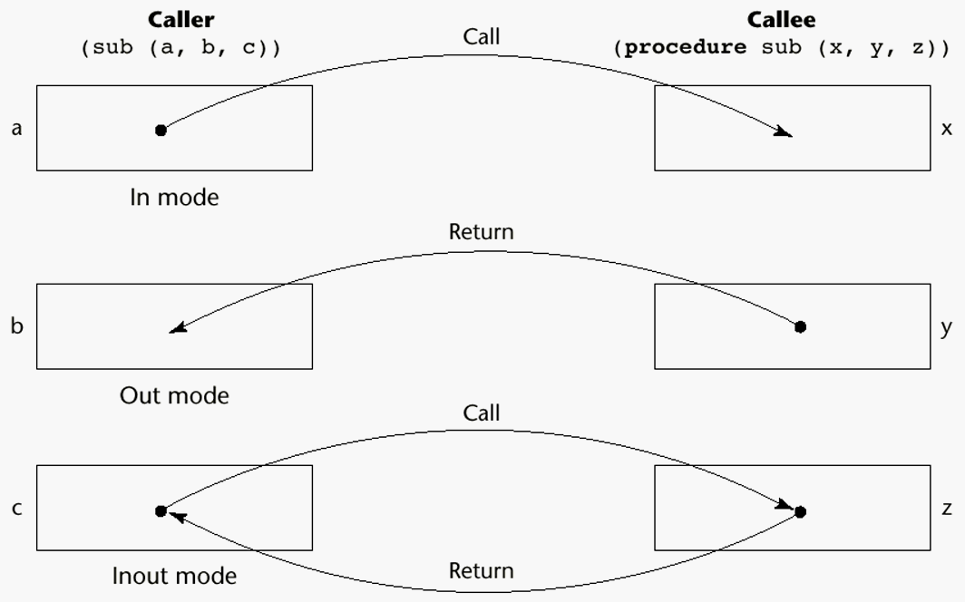
Models of Parameter Passing

Slide 11
Pass-by-Value (In Mode)
The value of the actual parameter is used to initialize the corresponding formal parameter
Normally implemented by copying
Can be implemented by transmitting an access path but not recommended (enforcing write protection is not easy)
Disadvantages (if by physical move): additional storage is required (stored twice) and the actual move can be costly (for large parameters)
Disadvantages (if by access path method): must write-protect in the called subprogram and accesses cost more (indirect addressing)

Slide 12
Example
double f (double x) { …; }
double d = 3.4;
cout << f(d) << f(5) << endl;
//two calls to f by passing value to x

Slide 13
More examples
What about the following C functions?
void swap1 (int a, int b)
{int t=a; a=b; b=t; return; }
void swap2 (int *pa, int *pb)
{int t = *pa, *pa=*pb; *pb=t; return;}
//how to call this function to swap two integers n and m?
Which one(s) used pass-by-value?

Slide 14
Pass-by-Result (Out Mode)
When a parameter is passed by result, no value is transmitted to the subprogram; the corresponding formal parameter acts as a local variable; its value is transmitted to caller’s actual parameter when control is returned to the caller, by physical move
Require extra storage location and copy operation
Potential problem: sub(p1, p1); whichever formal parameter is copied back will represent the current value of p1

Slide 15
Pass-by-Value-Result (inout Mode)
A combination of pass-by-value and pass-by-result
Sometimes called pass-by-copy
Formal parameters have local storage
Disadvantages:
Those of pass-by-result
Those of pass-by-value

Slide 16
Pass-by-Reference (Inout Mode)
Pass an access path
Also called pass-by-sharing
Advantage: Passing process is efficient (no copying and no duplicated storage)
Disadvantages
Slower accesses (compared to pass-by-value) to formal parameters
Potentials for unwanted side effects (collisions)
Unwanted aliases (access broadened)

Slide 17
Example in C++
void swap3 (int &a, int &b)
{int t=a; a=b; b=t; return;}
int data1 = 5, data2=8;
swap3(data1, data2);
cout << data1 << “ “ << data2 << endl;
//Compare with swap1 and swap2 in previous slides
//Write a piece of code in Java to swap two integers

Slide 18
Pass-by-value-result vs. pass-by-reference
void multiply (int m, int n) {
n = n+1; m = m * n; return; }
Code1:
k=5; j=3; multiply(k,j);
//what will be the values for k and j after the function call?
Code 2:
k=5, j=3; multiply(k,k);
//any difference: pass-by-value-result & pass-by-reference?

Slide 19
Pass-by-Name (Inout Mode)
By textual substitution
Formals are bound to an access method at the time of the call, but actual binding to a value or address takes place at the time of a reference or assignment
Allows flexibility in late binding

Slide 20
Example (ALGOL-like syntax)
procedure sum (i, j);
integer i,j;
begin
integer s;
s=0;
for i:=1 step 1 until 100 do s := s + j;
sum = s; //must assign return value to procedure name
end;
Under pass-by-name:
(1) What is the result of calling sum(i,i*10)?
(2) What is the result of calling sum(i,a[i]*b[i])?

Slide 21
Implementing Parameter-Passing Methods
In most language parameter communication takes place thru the run-time stack
Pass-by-reference are the simplest to implement; only an address is placed in the stack
A subtle but fatal error can occur with pass-by-reference and pass-by-value-result: a formal parameter corresponding to a constant can mistakenly be changed

Slide 22
Parameter Passing Methods of Major Languages
C
Pass-by-value
Pass-by-reference is achieved by using pointers as parameters
C++
A special pointer type called reference type for pass-by-reference
Java
All primitive parameters are passed by value
Object parameters are passed by reference
Ada
Three semantics modes of parameter transmission: in, out, in out; in is the default mode
Formal parameters declared out can be assigned but not referenced; those declared in can be referenced but not assigned; in out parameters can be referenced and assigned

Slide 23
Parameter Passing Methods of Major Languages (continued)
Fortran 95 - Parameters can be declared to be in, out, or inout mode
C# - Default method: pass-by-value
Pass-by-reference is specified by preceding both a formal parameter and its actual parameter with ref (also, out may be used, similar to ref, but no initial value required)
PHP: very similar to C#
Perl: all actual parameters are implicitly placed in a predefined array named @_
Python and Ruby use pass-by-assignment (all data values are objects)

Slide 24
Type Checking Parameters
Considered very important for reliability
FORTRAN 77 and original C: none
Pascal, FORTRAN 90, Java, and Ada: it is always required
ANSI C and C++: choice is made by the user
Prototypes
Relatively new languages Perl, JavaScript, and PHP do not require type checking
In Python and Ruby, variables do not have types (objects do), so parameter type checking is not possible

Slide 25
Multidimensional Arrays as Parameters
If a multidimensional array is passed to a subprogram, the compiler needs to know the declared size of that array to build the storage mapping function
C and C++
Programmer is required to include the declared sizes of all but the first subscript in the actual parameter
Disallows writing flexible subprograms
Ada – not a problem
Constrained arrays – size is part of the array’s type
Unconstrained arrays - declared size is part of the object declaration

Slide 26
Multidimensional Arrays as Parameters (continued)
Fortran
Formal parameter that are arrays have a declaration after the header
For multidimensional arrays, the sizes are sent as parameters and used in the declaration of the formal parameter
Java and C#
Similar to Ada
Arrays are objects; they are all single-dimensioned, but the elements can be arrays
Each array inherits a named constant (length in Java, Length in C#) that is set to the length of the array when the array object is created

Slide 27
Design Considerations for Parameter Passing
Two important considerations
Efficiency
One-way or two-way data transfer
But the above considerations are in conflict
Good programming suggest limited access to variables, which means one-way whenever possible
But pass-by-reference is more efficient to pass structures of significant size

Slide 28
Parameters that are Subprogram Names
Sometimes we need to pass actions or functions (i.e. subprogram names) as parameters
Issues:
Are parameter types checked?
What is the correct referencing environment for a subprogram that was sent as a parameter?

Slide 29
Parameters that are Subprogram Names: Parameter Type Checking
C and C++: functions cannot be passed as parameters but pointers to functions can be passed and their types include the types of the parameters, so parameters can be type checked
FORTRAN 95 type checks
Ada does not allow subprogram parameters; an alternative is provided via Ada’s generic facility
Java does not allow method names to be passed as parameters

Slide 30
Example: Pointer to function
bool *compare (int, int);
void selection_sort (int [], const int, bool(*) (int, int));
bool ascending (int a, int b) { … }
bool descending(int a, int b) { …}
Function calls:
selection_sort(list, size, ascending);
selection_sort(list, size, descending);

Slide 31
Parameters that are Subprogram Names: Referencing Environment
Shallow binding: The environment of the call statement that enacts the passed subprogram - Most natural for dynamic-scoped
languages
Deep binding: The environment of the definition of the passed subprogram - Most natural for static-scoped languages
Ad hoc binding: The environment of the call statement that passed the subprogram

Slide 32
Example
function sub1 () {
var x;
function sub2() { … use x…};
function sub3() {
var x; x=3;
sub4(sub2); };
function sub4(subx) {var x; x=4; subx(); };
//below body of sub1
x=1;
sub3();
};

Slide 33
Overloaded Subprograms
An overloaded subprogram is one that has the same name as another subprogram in the same referencing environment
Every version of an overloaded subprogram has a unique protocol
C++, Java, C#, and Ada include predefined overloaded subprograms
In Ada, the return type of an overloaded function can be used to disambiguate calls (thus two overloaded functions can have the same parameters)
Ada, Java, C++, and C# allow users to write multiple versions of subprograms with the same name
An overloaded subprogram is one that has the same name as another subprogram in the same referencing environment
Every version of an overloaded subprogram has a unique protocol
C++, Java, C#, and Ada include predefined overloaded subprograms
In Ada, the return type of an overloaded function can be used to disambiguate calls (thus two overloaded functions can have the same parameters)
Ada, Java, C++, and C# allow users to write multiple versions of subprograms with the same name

Slide 34
Generic Subprograms
A generic or polymorphic subprogram takes types as parameters
Overloaded subprograms provide ad hoc polymorphism
Ada
Versions of a generic subprogram are created by the compiler when explicitly instantiated by a declaration statement
Generic subprograms are preceded by a generic clause that lists the generic variables, which can be types or other subprograms
C++
Versions of a generic subprogram are created implicitly when the subprogram is named in a call or when its address is taken with the & operator
Generic subprograms are preceded by a template clause that lists the generic variables, which can be type names or class names

Slide 35
Generic Subprograms (continued)
Java 5.0 - Differences between generics in Java 5.0 and those of C++ and Ada: 1. Generic parameters in Java 5.0 must be classes
2. Java 5.0 generic methods are instantiated just once as truly generic methods 3. Restrictions can be specified on the range of classes that can be passed to the generic method as generic parameters 4. Wildcard types of generic parameters
C# 2005 - Supports generic methods that are similar to those of Java 5.0 - One difference: actual type parameters in a call can be omitted if the compiler can infer the unspecified type

Slide 36
Examples of parametric polymorphism: C++
template <class Type>
Type max(Type first, Type second) {
return first > second ? first : second;
}
The above template can be instantiated for any type for which operator > is defined
int max (int first, int second) {
return first > second? first : second;
}

Slide 37
Design Issues for Functions
Are side effects allowed?
Parameters should always be in-mode to reduce side effect (like Ada)
What types of return values are allowed?
Most imperative languages restrict the return types
C allows any type except arrays and functions
C++ is like C but also allows user-defined types
Ada subprograms can return any type (but Ada subprograms are not types, so they cannot be returned)
Java and C# methods can return any type (but because methods are not types, they cannot be returned)
Python and Ruby treat methods as first-class objects, so they can be returned, as well as any other class
Lua allows functions to return multiple values

Slide 38
User-Defined Overloaded Operators
Operators can be overloaded in Ada, C++, Python, and Ruby
An Ada example
function "*" (A,B: in Vec_Type): return Integer is
Sum: Integer := 0;
begin
for Index in A'range loop
Sum := Sum + A(Index) * B(Index)
end loop
return sum;
end "*";
…
c = a * b; -- a, b, and c are of type Vec_Type

Slide 39
Coroutines
A coroutine is a subprogram that has multiple entries and controls them itself – supported directly in Lua
Also called symmetric control: caller and called coroutines are on a more equal basis
A coroutine call is named a resume
The first resume of a coroutine is to its beginning, but subsequent calls enter at the point just after the last executed statement in the coroutine
Coroutines repeatedly resume each other, possibly forever
Coroutines provide quasi-concurrent execution of program units (the coroutines); their execution is interleaved, but not overlapped

Slide 40
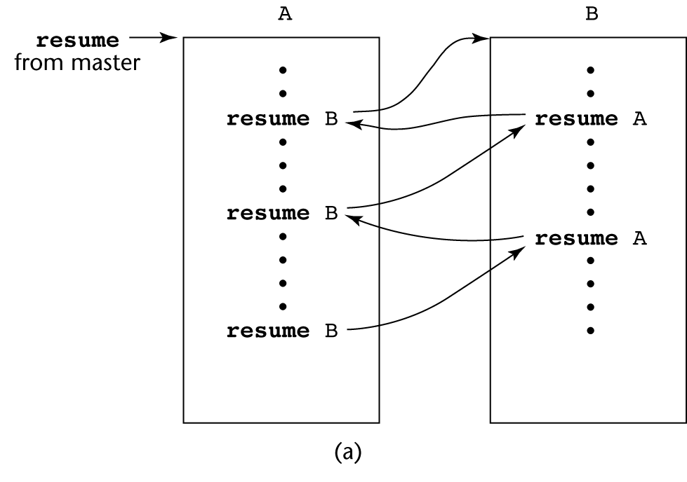
Coroutines Illustrated: Possible Execution Controls

Slide 41
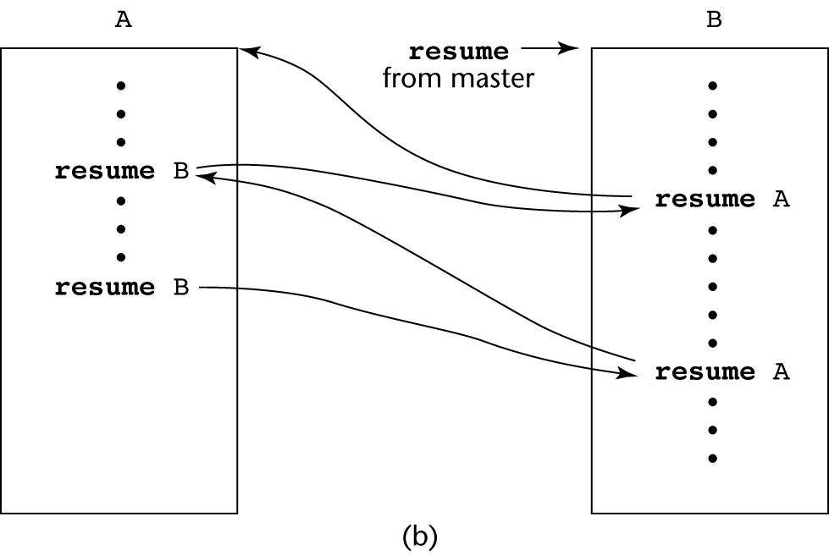
Coroutines Illustrated: Possible Execution Controls

Slide 42
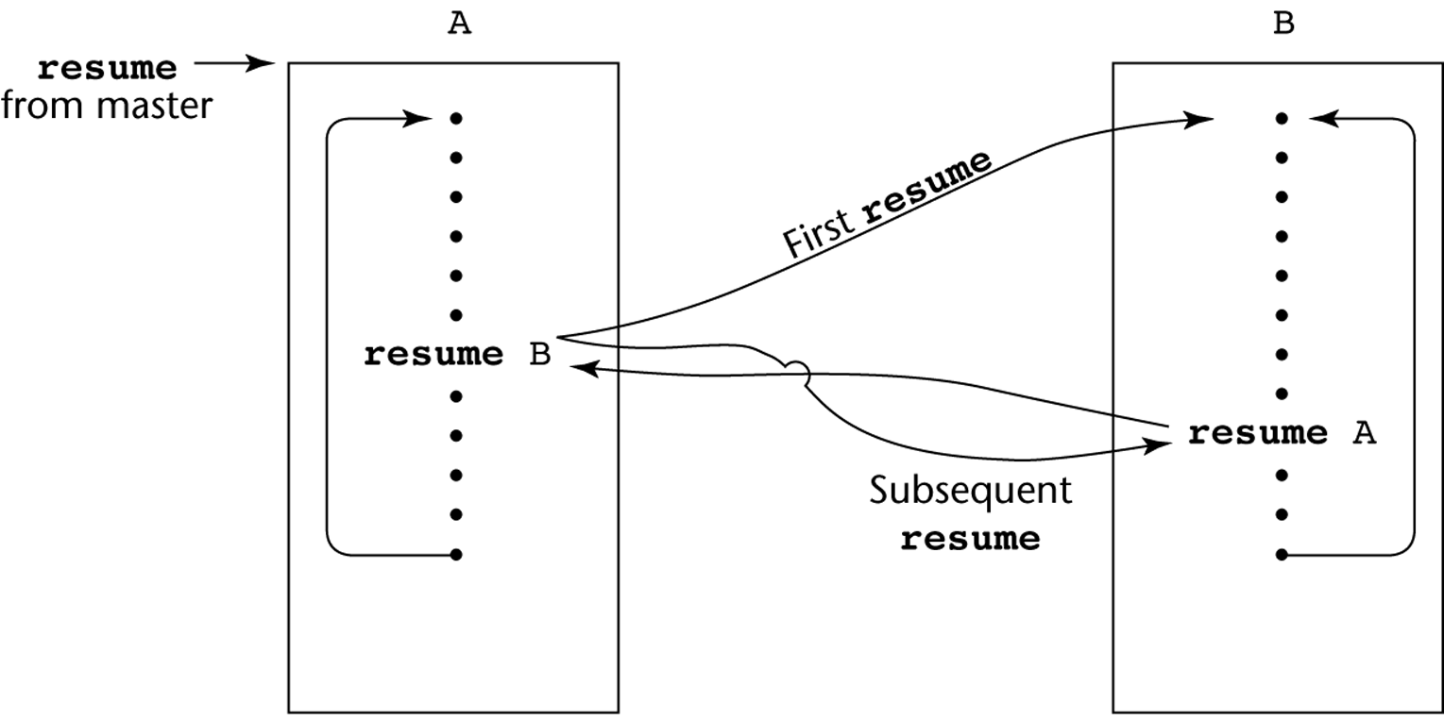
Coroutines Illustrated: Possible Execution Controls with Loops

Slide 43
Subprogram Implementations
The subprogram call and return operations of a language are together called its subprogram linkage
General semantics of calls to a subprogram
Parameter passing methods
Stack-dynamic allocation of local variables
Save the execution status of calling program
Transfer of control and arrange for the return
If subprogram nesting is supported, access to nonlocal variables must be arranged

Slide 44
Implementing “Simple” Subprograms
Call Semantics: - Save the execution status of the caller - Pass the parameters - Pass the return address to the called - Transfer control to the called
Required storage:
Status information, parameters, return address, return value for functions, temporaries
An activation record stores a collection of data for a particular subprogram activation

Slide 45
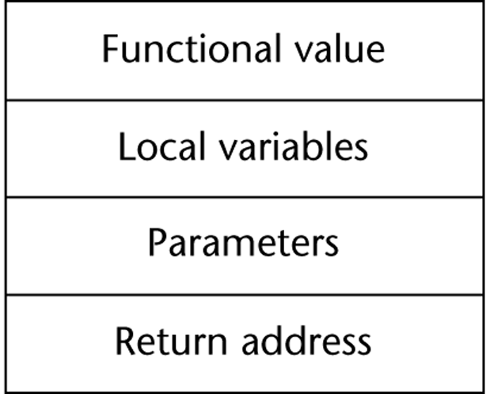
A Sample Activation Record

Slide 46
Activation Record and Dynamic link
The activation record format is static, but its size may be dynamic
When a subprogram is called, its activation record is dynamically created and resides on the run-time stack
The dynamic link points to the top of an instance of the activation record of the caller
The Environment Pointer (EP) must be maintained by the run-time system. It always points at the base of the activation record instance of the currently executing program unit

Slide 47
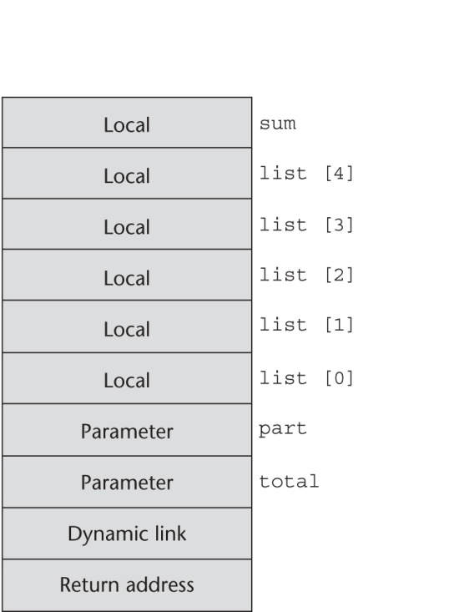
An Example: C Function
void sub(float total, int part)
{
int list[5];
float sum;
…
}

Slide 48
Subprogram Call/Return Actions
Caller Actions:
Create an activation record instance
Save the execution status of the current program unit
Compute and pass the parameters
Pass the return address to the called
Transfer control to the called
Actions of the called:
Parameter or return value: pass-by-result parameter and function return value (if any) are moved to corresponding actual parameter or return result locations
Restore the execution status of the caller
Transfer control back to the caller

Slide 49
Another Example
void fun1(float r) {
int s, t;
...
fun2(s);
...
}
void fun2(int x) {
int y;
...
fun3(y);
...
}
void fun3(int q) {
...
}
void main() {
float p;
...
fun1(p);
...
}
main calls fun1
fun1 calls fun2
fun2 calls fun3

Slide 50
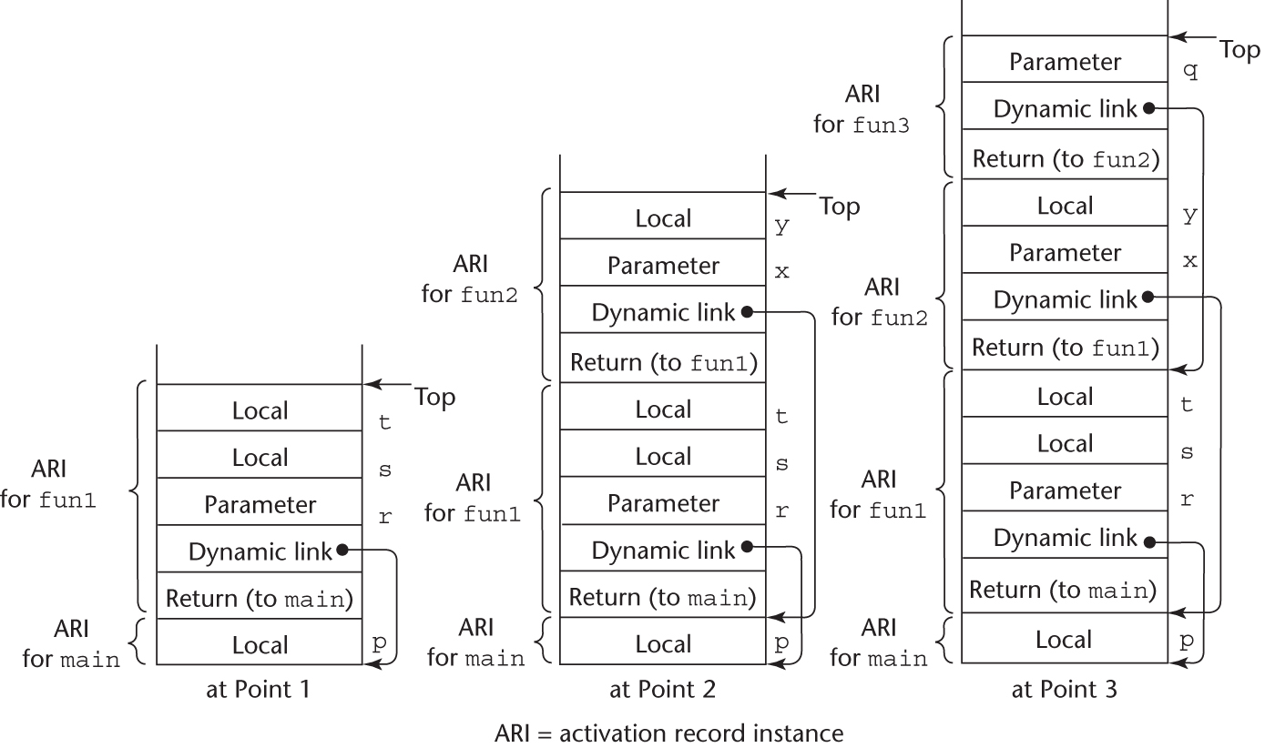
Stack support of function calls

Slide 51
Locating a Non-local Reference
Finding the offset is easy
Finding the correct activation record instance
Static semantic rules guarantee that all non-local variables that can be referenced have been allocated in some activation record instance that is on the stack when the reference is made
Implementation of static scoping and dynamic scoping
Static chain and dynamic chain

Slide 52
Implementing Static Scoping
A static link in an activation record for a subprogram points to its static parent’s activation record
The static chain from an activation record connects it to all of its static ancestors

Slide 53
Example Ada Program
procedure Main_2 is
X : Integer;
procedure Bigsub is
A, B, C : Integer;
procedure Sub1 is
A, D : Integer;
begin -- of Sub1
A := B + C; <-----------------------1
end; -- of Sub1
procedure Sub2(X : Integer) is
B, E : Integer;
procedure Sub3 is
C, E : Integer;
begin -- of Sub3
Sub1;
E := B + A: <--------------------2
end; -- of Sub3
begin -- of Sub2
Sub3;
A := D + E; <-----------------------3
end; -- of Sub2 }
begin -- of Bigsub
Sub2(7);
end; -- of Bigsub
begin
Bigsub;
end; of Main_2 }

Slide 54
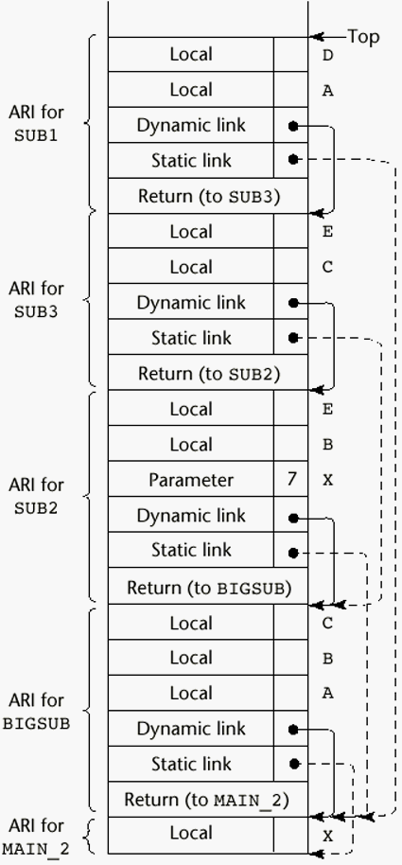
Stack Contents at Position 1

Slide 55
Implementing Dynamic Scoping
Deep Access: non-local references are found by searching the activation record on the dynamic chain - Length of the chain cannot be statically determined
Shallow Access: put locals in a central place
One stack for each variable name
Central table with an entry for each variable name
(details omitted)

Slide 56
Summary
A subprogram definition describes the actions represented by the subprogram
Subprograms can be either functions or procedures
Local variables in subprograms can be stack-dynamic or static
Three models of parameter passing: in mode, out mode, and inout mode
Some languages allow operator overloading
Subprograms can be generic
A coroutine is a special subprogram with multiple entries
Subprogram implementation: stack-based, static/dynamic chain for scoping resolution

